Slide 1

Chapter 6
Operations on Genomic intervals and genomic arithmetic

Slide 2
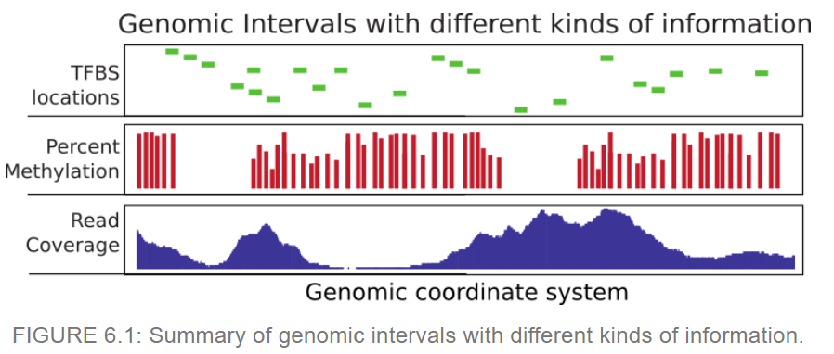
What analyses do we use after overlapping intervals of interest with other features of the genome?
In this chapter we explore ways to deal with genomic intervals
Notes:
An interval may for instance represent exon coordinates or a transcription factor binding site. On the other hand, you can have base-pair resolution, continuous scores over the genome such as read coverage, or scores that could be associated with only certain bases such as in the case of CpG methylation (see Figure 6.1 ).

Slide 3
6.1
GenomicRanges Package
We will use this package because it provides tools to do overlap operations
The package requires specific data types that make overlapping and related operations easier
These data types are conceptually like a data frame
Not everything that works for data frames will work on GRanges object
Notes:
Considerable time in computational genomics is spent on overlapping different features of the genome. Each feature can be represented with a genomic interval within the chromosomal coordinate system. In addition, each interval can carry different sorts of information. An interval may for instance represent exon coordinates or a transcription factor binding site.

Slide 4
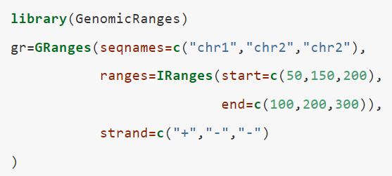
6.1
GenomicRanges Package
package
sequence names
argument
start and end positions of each genomic range
main object that holds the genomic intervals and extra information about those intervals
directionality of each genomic range
Notes:
it looks a bit like a data frame. Also, note that the peculiar second argument “ranges” basically contains the start and end positions of the genomic intervals. However, you cannot just give start and end positions, you actually have to provide another object of IRanges. Do not let this confuse you; GRanges actually depends on another object that is very similar to itself called IRanges and you have to provide the “ranges” argument as an IRanges object. In its simplest form, an IRanges object can be constructed by providing start and end positions to the IRanges() function. Think of it as something you just have to provide in order to construct the GRanges object.

Slide 5
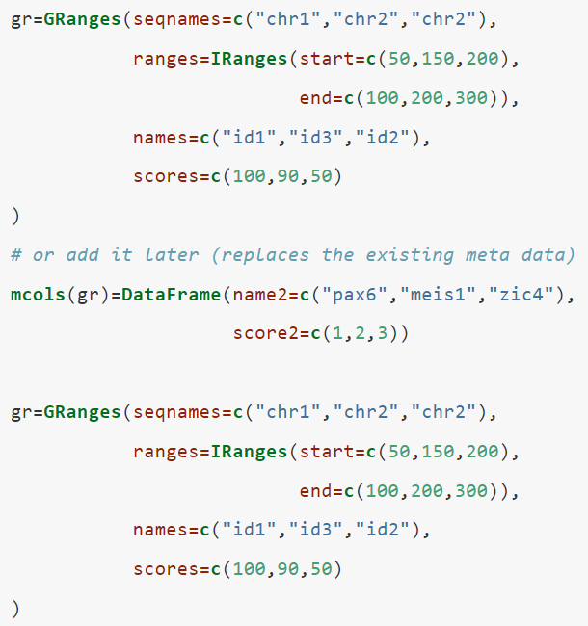

6.1
GenomicRanges Package
We can include more information about the genomic interval such as scores, names, etc. when we create the object...
… or retroactively add it to the gr object
We can also add data using the $ operator:

Slide 6
6.1
GenomicRanges Package
Ways to convert BED files into a GRanges object:
The rtracklayer package can directly import BED files and obtain the data in the GRanges format from online databases
Many other packages as well
Use the read.table() function to read data into a data frame
Follow with the grep() function to remove names with underscores
Create a GRanges object
Use the readTranscriptfeatures() function
OR
Notes:
You may need to do some pre-processing before/after reading in the BED file. Below is an example of getting transcription start sites from BED files containing RefSeq transcript locations. Another way of doing this from a BED file is to use the readTranscriptfeatures() function from the genomation package. This function takes care of the steps described in the code chunk above.

Slide 7
6.1
GenomicRanges Package
Frequently used file formats:
BED | The chromosome name, the start position and end position for a genomic feature of interest | Used by the UC Santa Cruz Genome Browser (genome sequence data)
GFF | a tabular text format for genomic features like-- but more flexible than-- BED | Harder to separate into more easily processed components. Many gene annotation files are in this format.
BAM | A compressed and indexed tabular file format designed for aligned sequencing reads | -
SAM | The uncompressed version of the BAM file | Contains basic chromosomal location information, columns related to the quality of alignment, and other relevant information
bigWig (Big Wiggle) | Scores associated with genomic intervals. It is an indexed format. | Easier to query and only necessary portions of the file can be in memory
Generic Text files | Any text file with the minimal information, start and end coordinates | -
Tabix/Bcf | Tabular file formats indexed and compressed like BAM | Mostly used to store genomic variation data such as SNPs and indels
Notes:
There are multiple file formats in genomics but some of them you will see more frequently than others. We already mentioned some of them. Here is a list of files and functions that can read them into R as GRanges objects or something coercible to GRanges objects.

Slide 8
6.1
GenomicRanges Package
One of the most common tasks in genomics: finding regions that do/do not overlap with another set of regions
The goal is to understand how different parts of the genome interact and the mechanisms that control genes
In section 6.1.3, ChIP-seq analysis output files are used to show how to annotate binding sites with CpG islands. Code is provided to find the following:
Subset of peaks that overlap
Counts of the number of peaks that overlap with a given CpG island
One-to-one overlaps between peaks and CpG islands
CpG islands - regions in the genome with a high density of CpG dinucleotides (a cytosine (C) followed by a guanine (G) nucleotide that are connected by a phosphate bond).
Notes:
Usually, you have a set of regions that you are interested in and you want to see if they overlap with another set of regions or see how many of them overlap. A good example is transcription factor binding sites determined by ChIP-seq experiments.
Below is a demonstration of how transcription factor binding sites can be annotated using CpG islands. First, we will get the subset of binding sites that overlap with the CpG islands. In this case, binding sites are ChIP-seq peaks.
However, you cannot just give start and end positions, you actually have to provide another object of IRanges. Do not let this confuse you; GRanges actually depends on another object that is very similar to itself called IRanges and you have to provide the “ranges” argument as an IRanges object. In its simplest form, an IRanges object can be constructed by providing start and end positions to the IRanges() function. Think of it as something you just have to provide in order to construct the GRanges object.

Slide 9
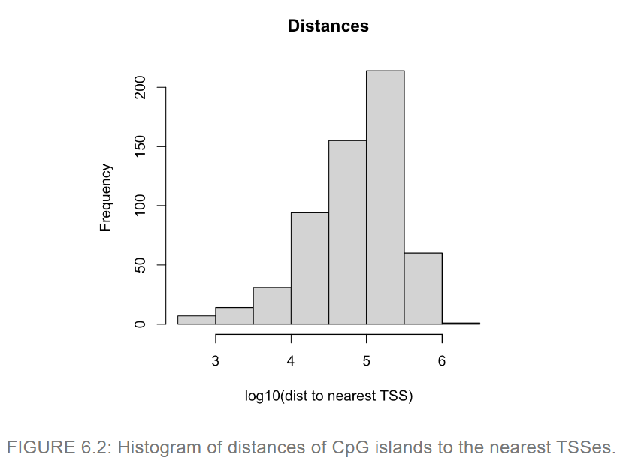
Distances to the nearest transcription start site (TSS) for each peak using the nearest() and distanceToNearest() functions
Notes:
Another interesting thing would be to look at the distances to the nearest CpG islands for each peak. In addition, just finding the nearest CpG island could also be interesting. Oftentimes, you will need to find the nearest TSS or gene to your regions of interest, and the code below is handy for doing that using the nearest() and distanceToNearest() functions, the resulting plot is shown in Figure 6.2.

Slide 10
6.2
Mapped high-throughput sequencing reads
Mapped reads are like genomic intervals stored in a file
After mapping, we quantify the enrichment of those aligned reads in the regions of interest
(similar to operations on genomic intervals)
Enrichment --> the frequency of reads in regions of interest
We often don't have the memory for all mapped reads (often BAM/SAM), so we use tools to query and quantify alignments on a given set of regions
Notes:
The phrase "quantify the enrichment" refers to the process of determining the relative number of reads that map to a particular region of the genome. This can be done by comparing the number of reads that align to a specific region of interest to the number of reads that align to the rest of the genome. Regions of the genome that have a higher number of aligned reads compared to the rest of the genome are considered enriched.

Slide 11
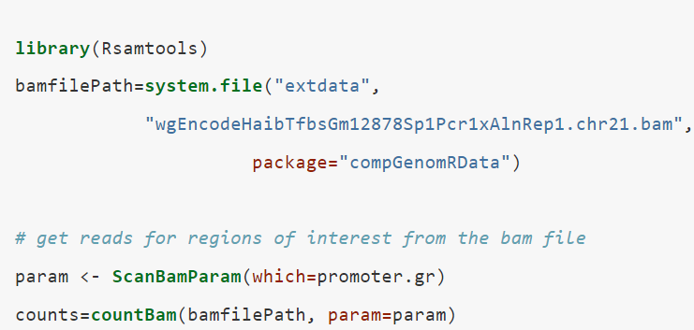
6.2
Mapped high-throughput sequencing reads
This is one way to count mapped reads for a set of regions using Rsamtools:
Creates object for the param argument with the parameters for scanning the BAM file
Function that queries the BAM file
ScanBamParam object

Slide 12
6.3
Dealing with continuous scores over the genome
Most high-throughput data can be viewed as a continuous score/ signal over the bases of the genome
This sort of data can be stored as a text file or can have special formats like Wig or bigWig (bigWig is good for large amounts of the genome with varying scores)
In R/Bioconductor, continuous data can also be represented in a compressed format, called Rle (run-length encoded) vector

Slide 13
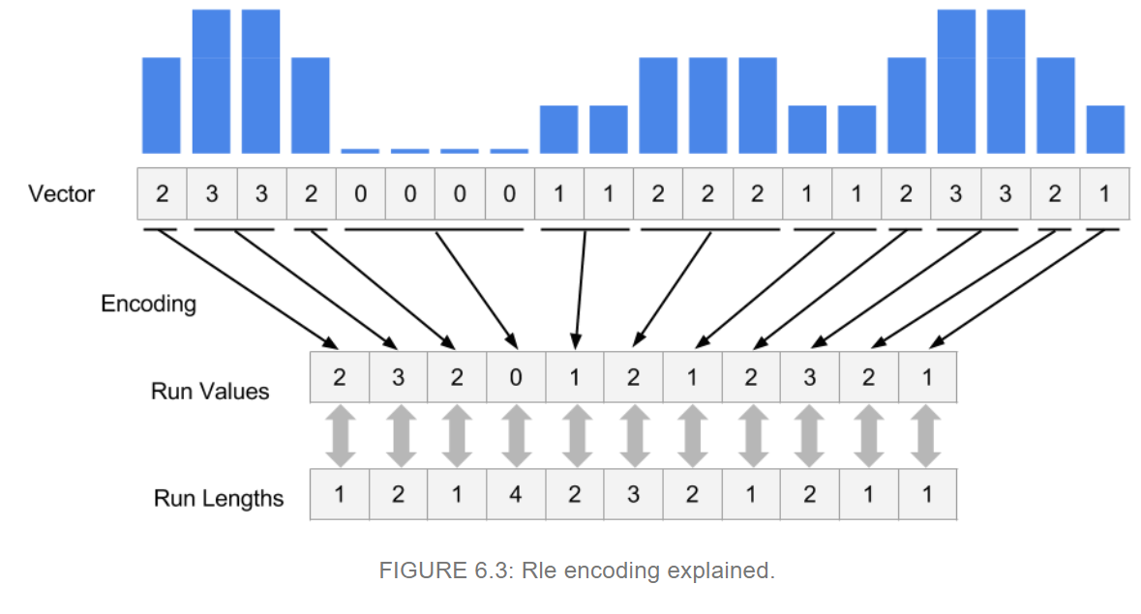
6.3
Dealing with continuous scores over the genome
Rle vectors have superior memory performance over regular vectors because repeating consecutive values are represented as one value

Slide 14

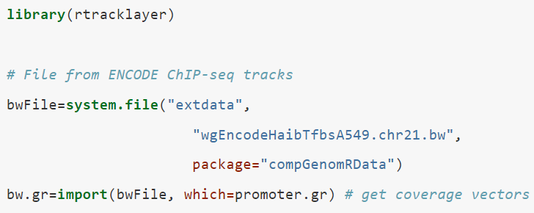
6.3
Dealing with continuous scores over the genome
For genome-wide data you sometimes have an RleList object (a list of Rle vectors per chromosome). You can obtain these vectors by getting the coverage:
The wig or bigWig format is one of the most common ways of storing score data
We can extract only the needed information from a bigWig file and read it into R using the rtracklayer package
Use GenomicRanges to get a list of Rle vectors:
Get the coverage directly from a BAM file:
Or
GRanges object with scores per genomic region
Don't read in the whole bigWig file (too big)

Slide 15
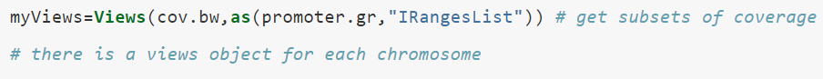
6.3
Dealing with continuous scores over the genome
How do we extract subsections of Rle and RleList objects to visualize or to do stats?
The book demonstrates by extracting promoter regions from ChIP-seq read coverage:

Slide 16
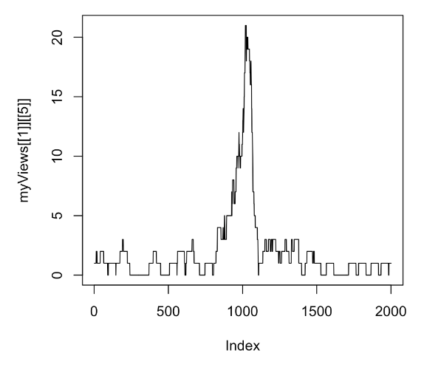

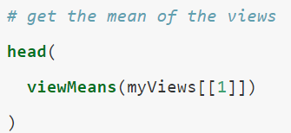
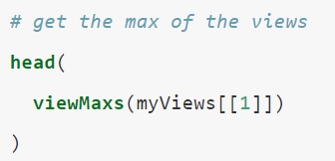
6.3
Dealing with continuous scores over the genome
How to plot one of the promoter’s coverage values:
Next, we see how to apply summary statistics:

Slide 17
6.4
Genomic intervals with more information
Genomic data often have many layers
Sometimes with many tables and each table may have some metadata associated with it
Rows and columns might have additional annotations that cannot be contained by their names
For these cases we can use the SummarizedExperiment class, which can hold multi-layered tabular data

Slide 18
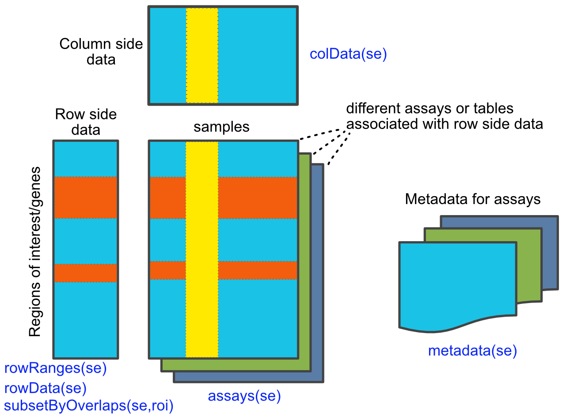
6.4
Genomic intervals with more information

Slide 19
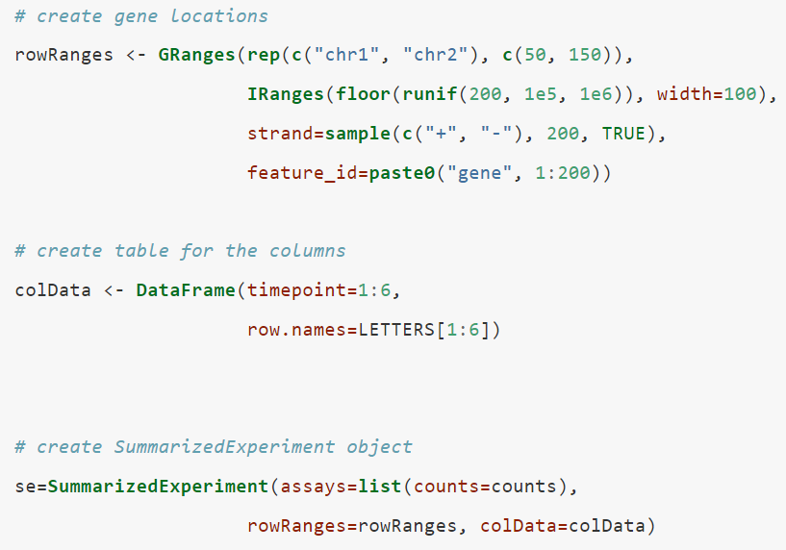
6.4
Genomic intervals with more information
How to create a basic SummarizedExperiment object:
GRanges object representing the locations of the genes
Table for column annotation
Matrix of read counts from a series of RNA-seq experiments from different time points
SummarizedExperiment object made by combining all pieces

Slide 20
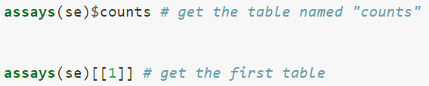

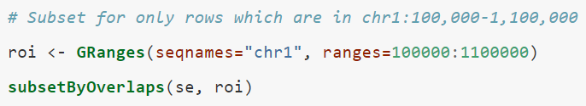
6.4
Genomic intervals with more information
How to subset it and extract/change parts of a SummarizedExperiment object:
extract the column-associated and row-associated tables
Extract the main table or tables that contain the values of interest
Subset using [ ] notation (similar to the way we subset data frames or matrices)
These objects can also support all of the findOverlaps() methods and associated functions that work on GRanges objects

Slide 21
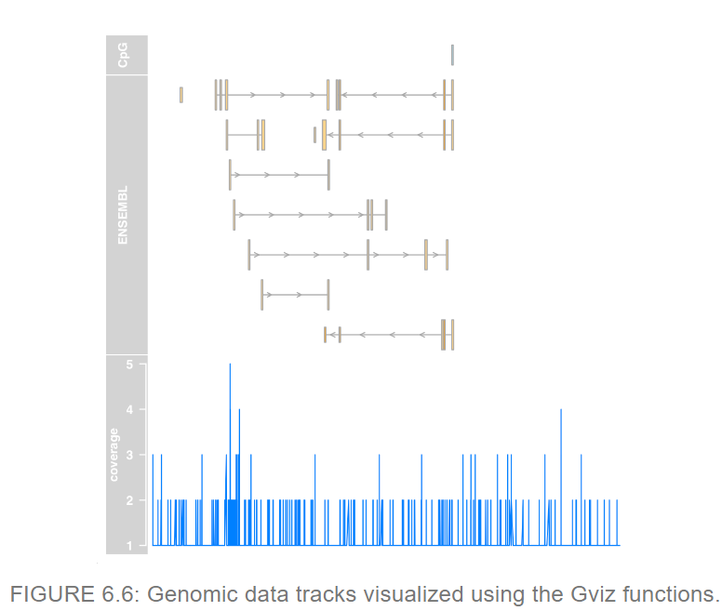
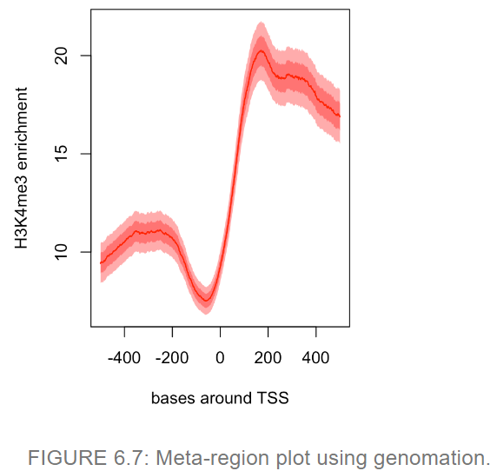
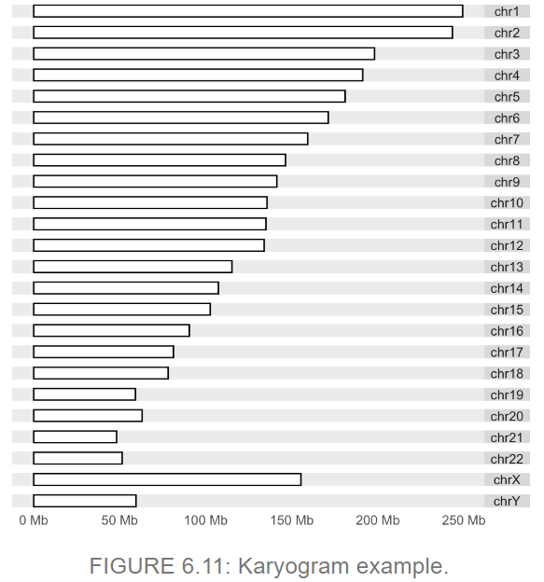
6.5
Visualizing and summarizing genomic intervals
We are shown some ways to integrate and visualize genomic intervals:
Visualizing intervals on a locus of interest
Summaries of genomic intervals on multiple loci
Making karyograms and circos plots

Slide 22
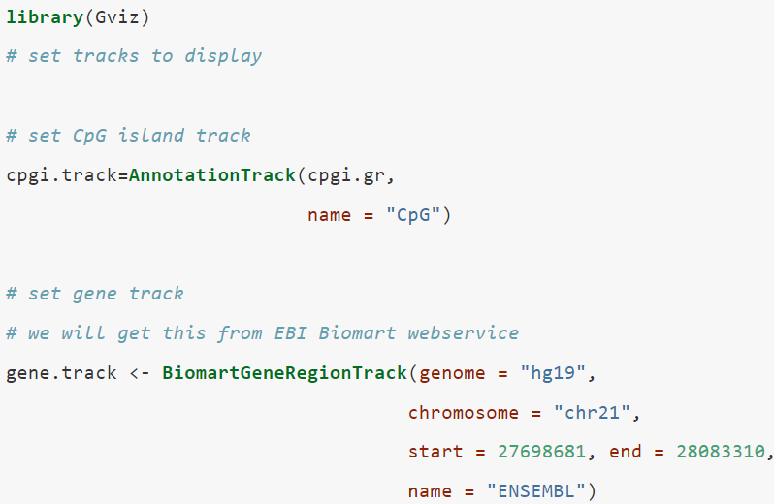
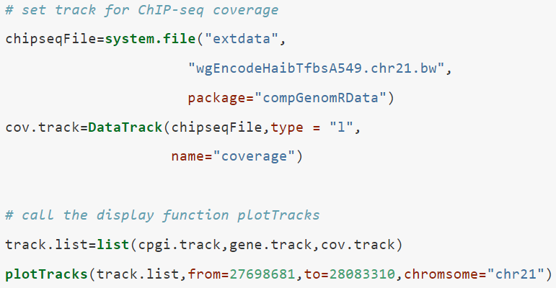
6.5
Visualizing and summarizing genomic intervals
How to visualize different genomic datasets over a particular genomic locus using the Gviz package:
Tracks (different types of genomic data) to display
Function that displays tracks

Slide 23
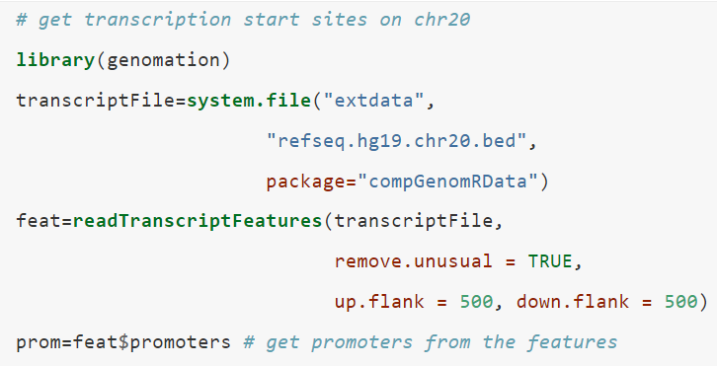
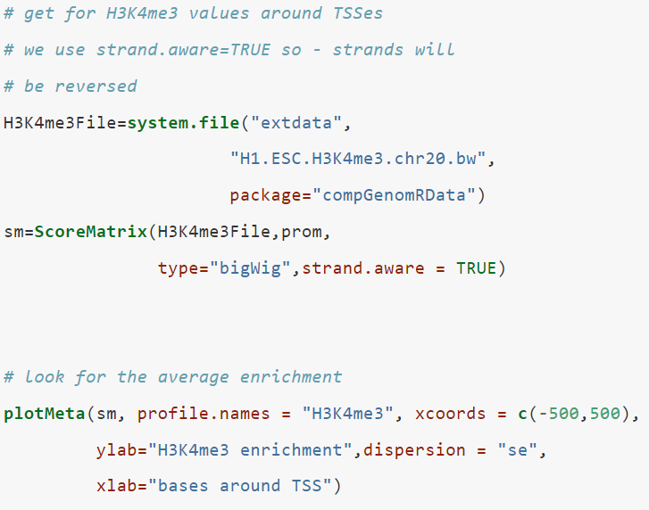
6.5
Visualizing and summarizing genomic intervals
How to visualize & summarize different data sets over many regions of interest & identify patterns using the genomation package:
Extract region around transcription start sites, 500bp upstream and downstream
Create a matrix of ChIP-seq scores Each row represents a region around a specific TSS. Columns are scores per base.
Plot average enrichment values around the TSS
Notes:
Enrichment = the extent to which a particular protein of interest is bound to a specific genomic region?

Slide 24

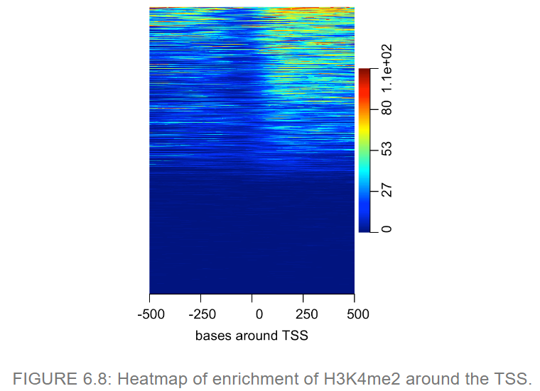
6.5
Visualizing and summarizing genomic intervals
Heatmap where each row is a region around the TSS and color coded by enrichment:
~ half of the regions don't have any signal
Some regions have signal on both sides of the TSS while others have signal mostly on the downstream side.
Notes:
Enrichment = the extent to which a particular protein of interest is bound to a specific genomic region?
in sequencing experiments, such as ChIP-seq, the signal-to-noise ratio is a measure of the quality of the signal, which represents the specific signal that we are interested in, in relation to the noise, which represents any background or non-specific signals that might be present in the experiment. The signal-to-noise ratio is calculated by dividing the average signal intensity of the peaks of interest by the average signal intensity of the control regions, which are regions that are not expected to be enriched for the signal of interest.

Slide 25
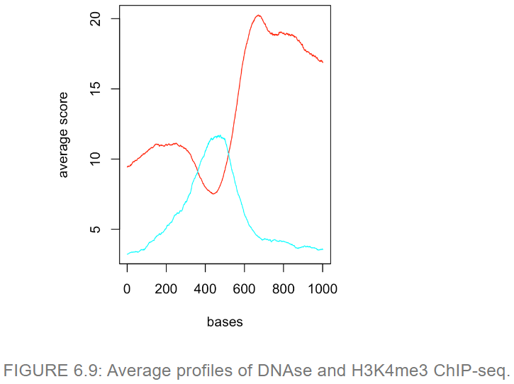
6.5
Visualizing and summarizing genomic intervals
Making a meta-region plot:
DNAse-seq data is used to create a list of matrices with the datasets
The average profile of the signals from both datasets are plotted

Slide 26
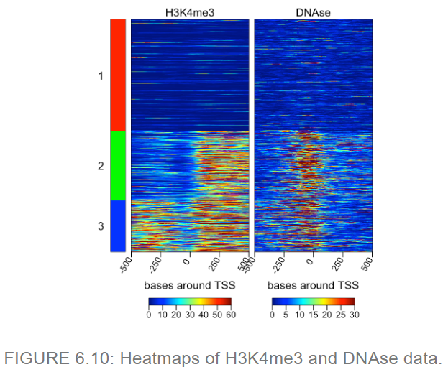
6.5
Visualizing and summarizing genomic intervals
We can view the heatmaps for both datasets and cluster the rows based on their similarity (multiHeatMatrix function)
Next, limit extreme values (winsorize argument) by equalizing scores above the 95th percentile to that value
About 50% of the promoters lack signal for either dataset, suggesting that the associated genes are not expressed

Slide 27
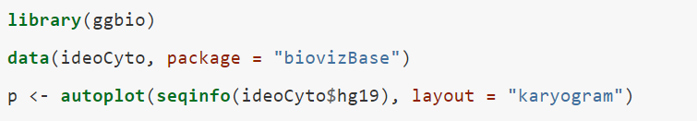
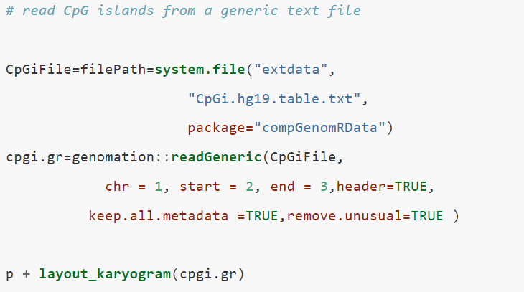
6.5
Visualizing and summarizing genomic intervals
Chromosomal karyograms and circos plots are good for displaying data over the whole genome of chromosomes of interest
They are best for showing large trends
ggbio package for plotting (syntax follows “grammar of graphics” logic, and depends on ggplot2)
The code on this slide uses the sizes of chromosomes to make a karyogram template

Slide 28
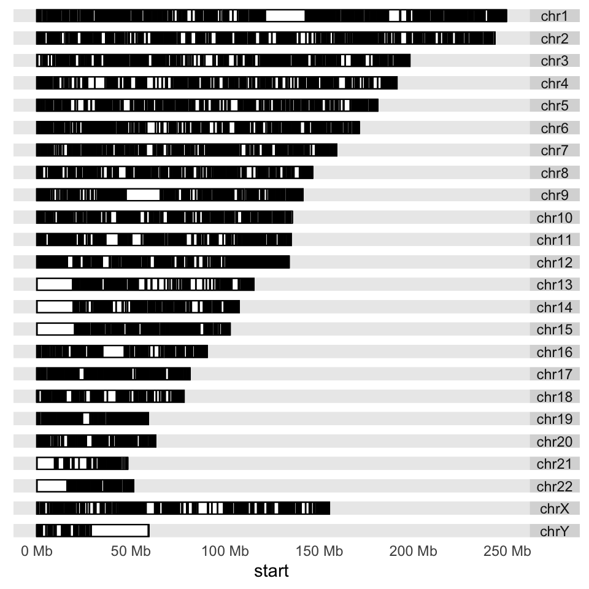
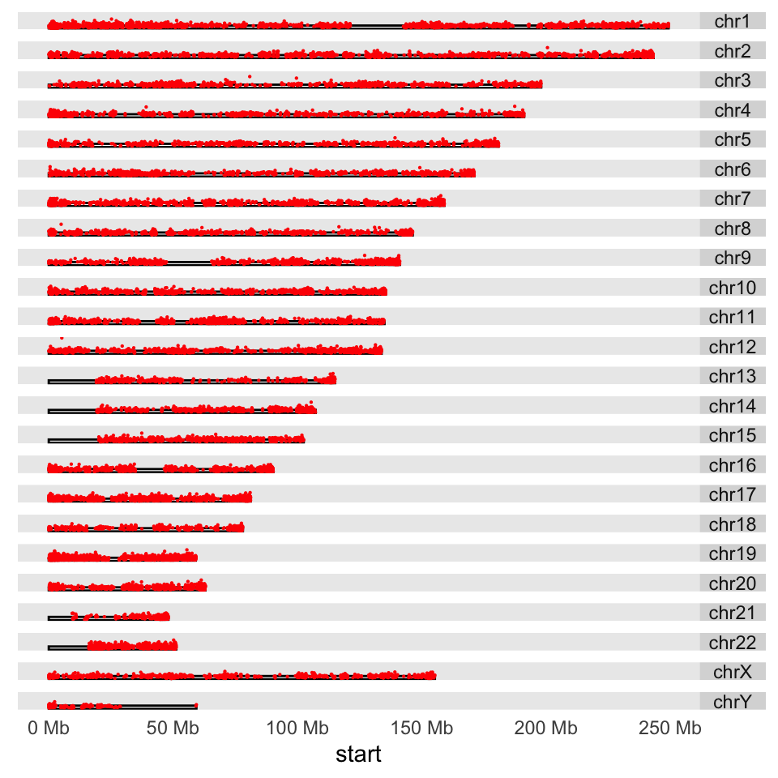
6.5
Visualizing and summarizing genomic intervals
Adding the CpG island scores:
Plot a point proportional to “obsExp” column from the data
Squish the chromosomal rectangles and plot on top
Use aes to map the geometry
Adding CpG islands to the karyogram using the layout_karyogram() function:

Slide 29
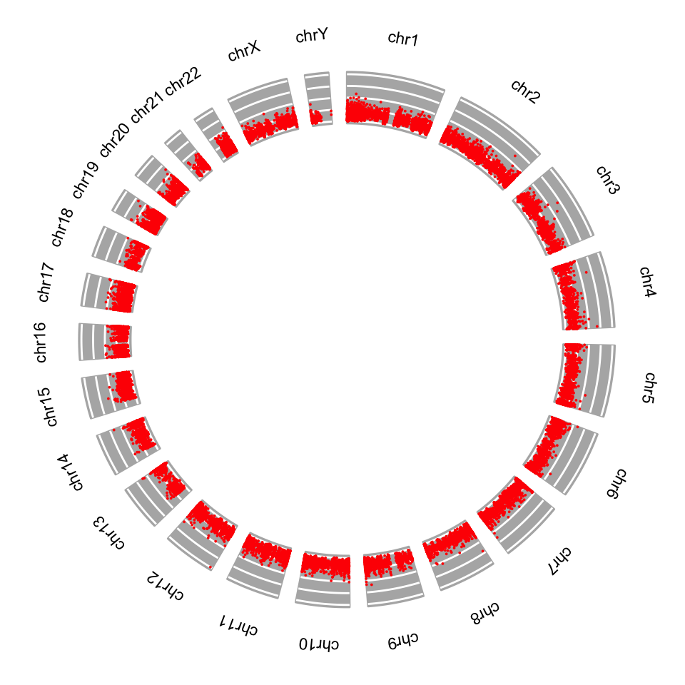
6.5
Visualizing and summarizing genomic intervals
These circular plots are for showing chromosomal rearrangements, but can also be used for depicting signals
Circos plot using the CpG island score example:

